Slide 1
Customer Churn Prediction
By, Emma, Jason and Sam.

Slide 2
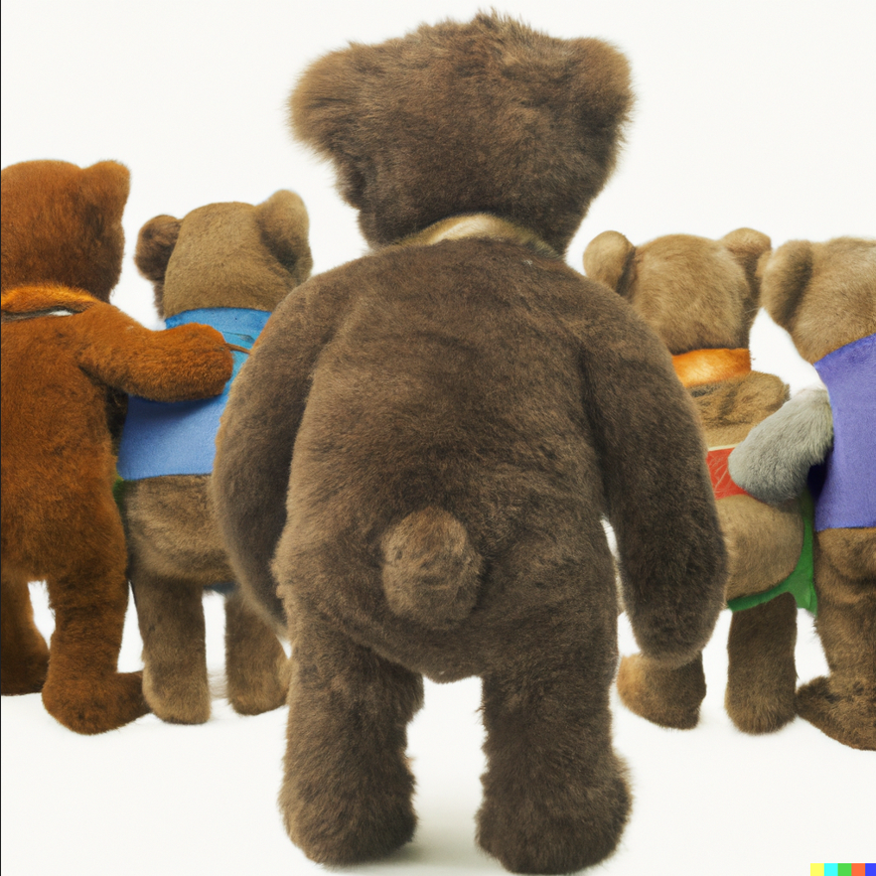
About the Project
The objective of this project is to understand and predict customer churn for a bank.
Specifically, we will initially perform Exploratory Data Analysis (EDA) to identify the factors contributing to customer churn.
This analysis will later help us build Machine Learning models to predict whether a customer will churn or not.

Slide 3
Machine Learning models:
There are a number of techniques that can be used to predict customer churn, including machine learning algorithms ;
Neural Network
Logistic regression
Random Forest
K-Nearest Neighbour
To increase efficiency, you can use advanced algorithms;
XGBoost
LightGBM

Slide 4
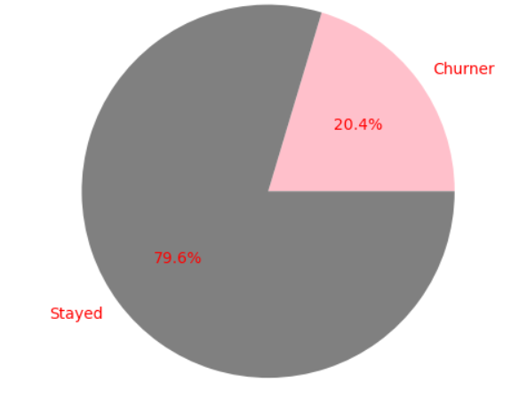
Dataset for ML Training
Dataset contains 10,000 unique customer id and each has 10 features.
Features included:
Geography (categorical)
Gender (categorical)
Age
Tenure
Balance
Number of products
Credit card or not
Active or not
Estimated Salary
Credit score

Slide 5
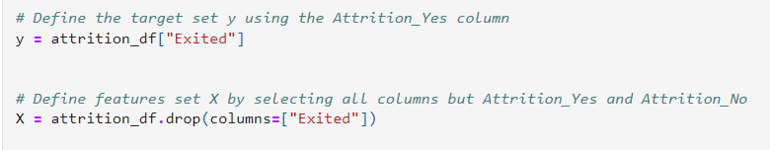
Data preparation
Data cleaning: checking null value use function of “isnull”
Combine both encoded features with original dataset as new dataframe called “attribtion_df”
Declared “Existed” as target column, and the rest being X features
Split into 3 lots for training, validation and test
Use of StandardScaler from sklearn.preprocessing

Slide 6
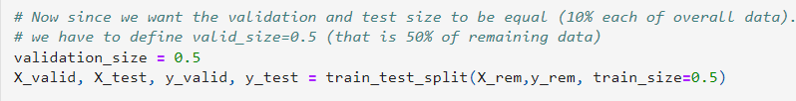
Training, Validation and Testing Sets
Using the function train_test_split from the scikit-learn library in Python. This function is used to split a given dataset into two subsets: a training set and a test set.
Step 1:
Step 2:

Slide 7
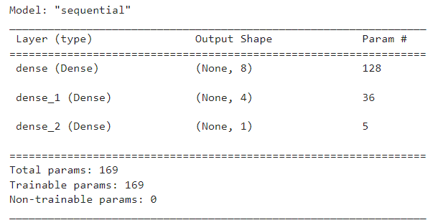
Model Structure
Neural Network
This code is creating a deep neural network model with two hidden layers using TensorFlow's Sequential model class.
The number of input features is determined by counting the columns in the training set.
The number of hidden nodes in the hidden layers are calculated using the mean of the number of input features and the number of output neurons, and the floor division operator (//). The model is then displayed using the summary method.

Slide 8
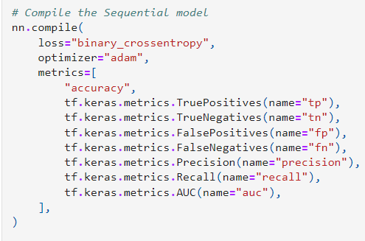
Compiling the Model
Neural Network
We compile the Sequential model using loss function of ‘binary_crossentropy’, the ‘adam’ optimizer, and the various metric.
The loss function of ‘binary_crossentropy’ is used for binary classification problem;
‘Adam’ is a popular optimisation algorithm for training nn;
In this case, metric “Recall” is what we will be compared against other model.

Slide 9
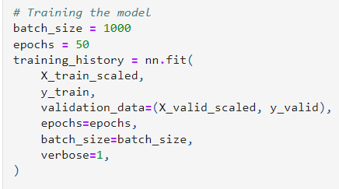
Training the Model
Neural Network
We train model using scaled training dataset, and tuning with validation dataset:
epochs parameter is set to 50, which means that the model will be trained for 50 iterations over the entire training set.
batch_size is set to 1000, which means that the model's parameters will be updated after every 1000 samples.
verbose parameter is set to 1, it will show a progress bar during training
training_history variable will store the record of the training process, including the values of the loss function and the metrics during each epoch. This can be used to analyze the training process and make adjustments as needed.

Slide 10
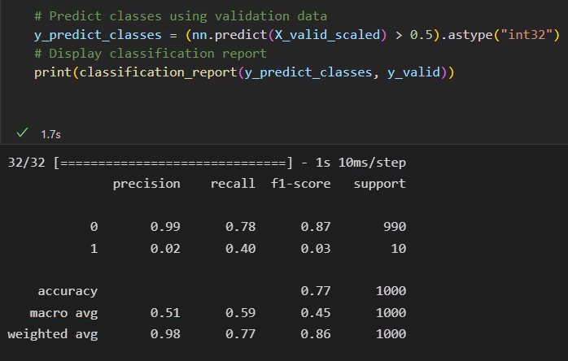
Evaluating the model
Neural Network
This problem is a typical classification task, the use of recall (i.e. ratio of true positive prediction made out of total positive cases in the dataset) as performance metrics are more relevant in this case, since correctly classifying elements of the positive class (customers who will churn) is more critical for the bank.

Slide 11
Logistic Regression Model using training data
Logistic Regression Model
We imported the LogisticRegression module from the sklearn library and instantiated a Logistic Regression model using the LogisticRegression class. We set the solver parameter to 'lbfgs' and the random_state parameter to 1. We then fit the model to the training data using the fit method of the LogisticRegression class, passing in the training data and the target variable.
Finally, we used the testing data to make predictions using the predict method and stored the predictions in a variable called "predictions".

Slide 12
Calculate accuracy score, Generate a confusion matrix and print the classification report
Logistic Regression Model
The results show that the model has an accuracy of 0.5789, with a precision of 0.82 for predicting when a customer will leave and a precision of 0.58 for predicting when a customer will stay.
The model also has a recall of 0.96 for predicting when a customer will leave and a recall of 0.19 for predicting when a customer will stay.
The f1-score for predicting when a customer will leave is 0.89 and the f1-score for predicting when a customer will stay is 0.29.
The support for predicting when a customer will leave is 1991 and the support for predicting when a customer will stay is 509.

Slide 13

Using the RandomOverSampler to resample the data
Logistic Regression Model
We used the RandomOverSampler module from the imbalanced-learn library to resample the data and balance the labels. We instantiated the random oversampler model, set the random_state parameter to 1, and fit the original training data to the model. We then counted the distinct values of the resampled labels data and confirmed that the labels now have an equal number of data points.

Slide 14
Using the LogisticRegression classifier and the resampled data to fit the model.
Logistic Regression Model
First, we instantiated the Logistic Regression model and set a random_state parameter of 1. Then, we fit the model using the resampled training data and made a prediction using the testing data. The resulting predictions were stored in a variable called resampled_predictions.

Slide 15
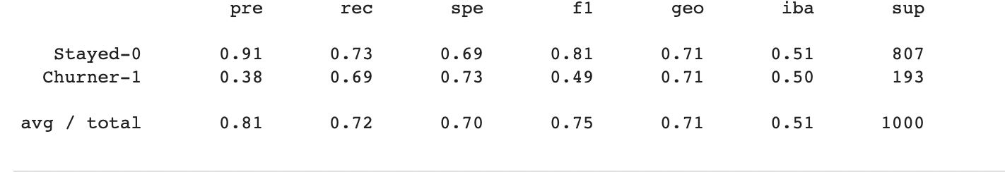
Evaluating the model
Logistic Regression Model

Slide 16
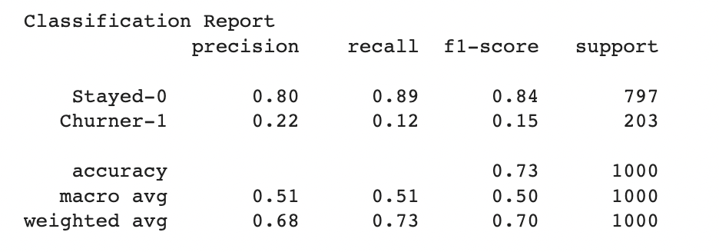
Modeling using Random Forest

Slide 17
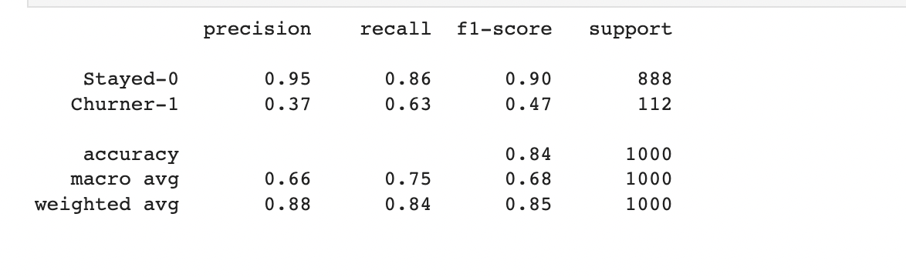
Modelling using K-Nearest Neighbors

Slide 18
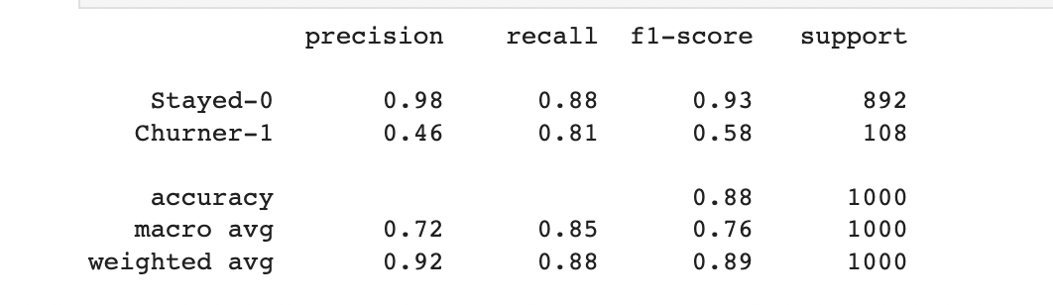
Modelling using XGBoost

Slide 19
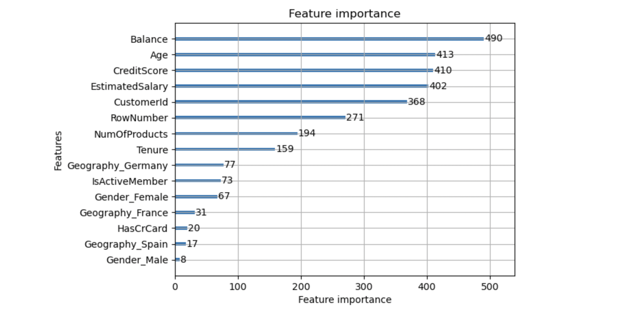
Modelling using LightGBM

